Slide 1









Beyond TinyML
Balance inference, accuracy and latency on MCUs
Anastassios Nanos, Anastasia Mallikopoulou
Notes:
Motivation: ML everywhere, but hardware everywhere is unequal

Slide 2




Why this matters
The problem
IoT devices want ML inference close to the data
ML models require memory & compute
Network connectivity is unreliable
Key tension
Accuracy vs latency vs energy vs deployability
Notes:
Emphasize real deployments, not toy benchmarks
Highlight ESP32-class devices

Slide 3
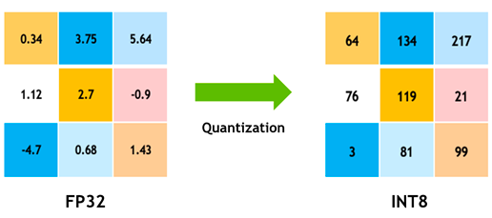
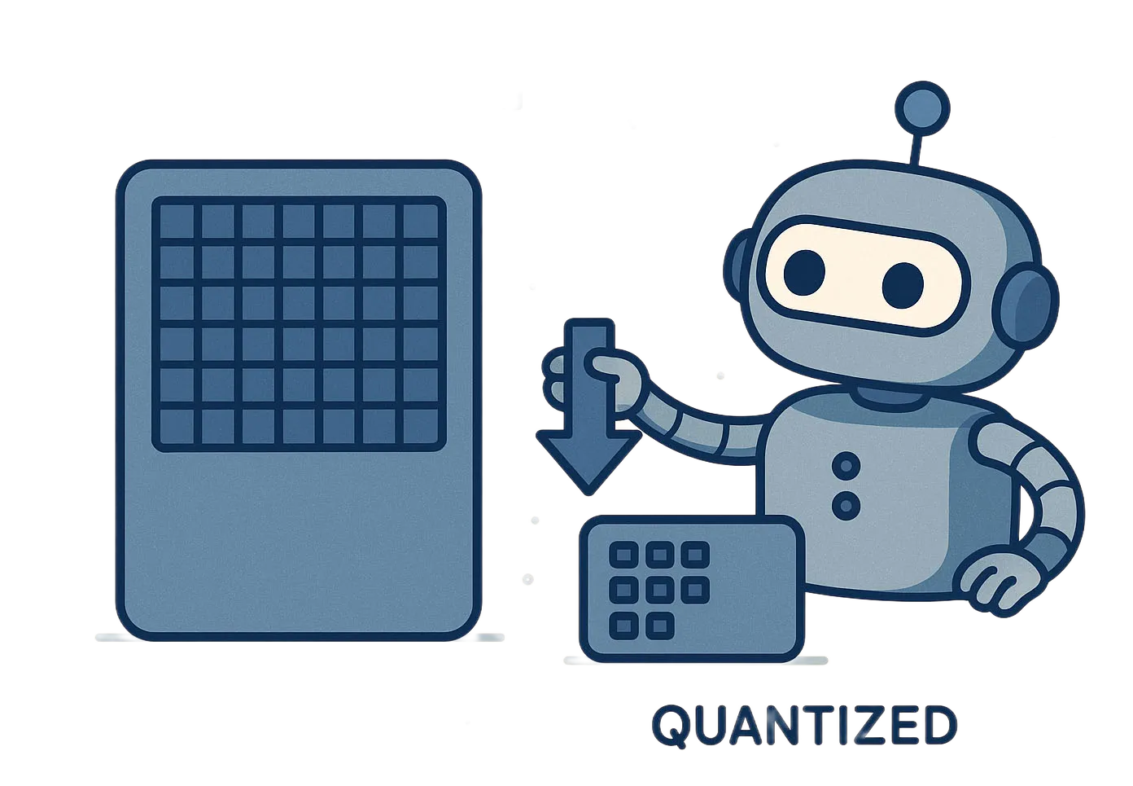

ML on IoT: The Reality
Local Inference
Limited RAM (MBs) forces heavy quantization
Quantization hurts model accuracy
End-to-end latency in seconds
Key tension
Accuracy vs latency vs energy vs deployability
Notes:
Stress that neither extreme works alone

Slide 4
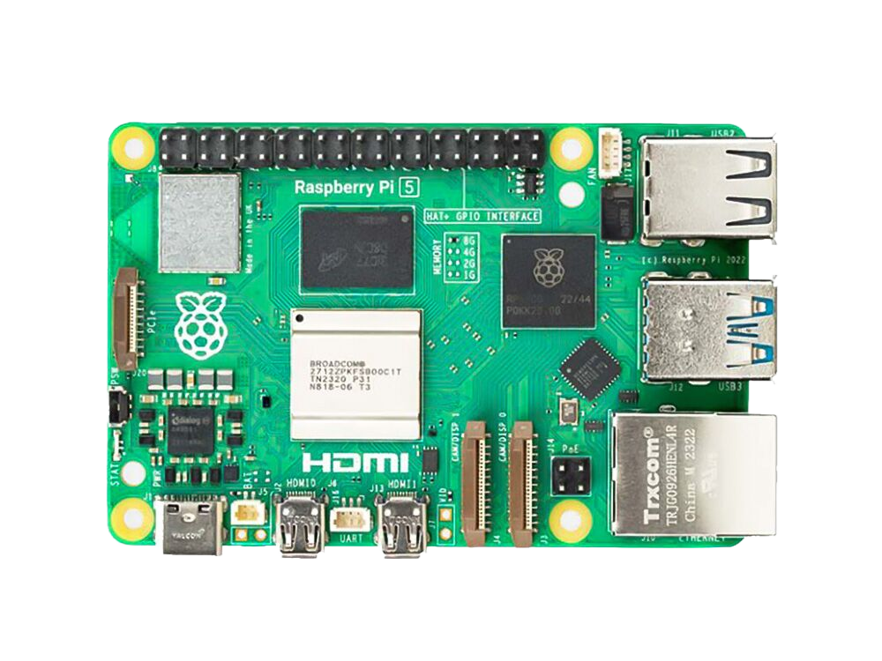
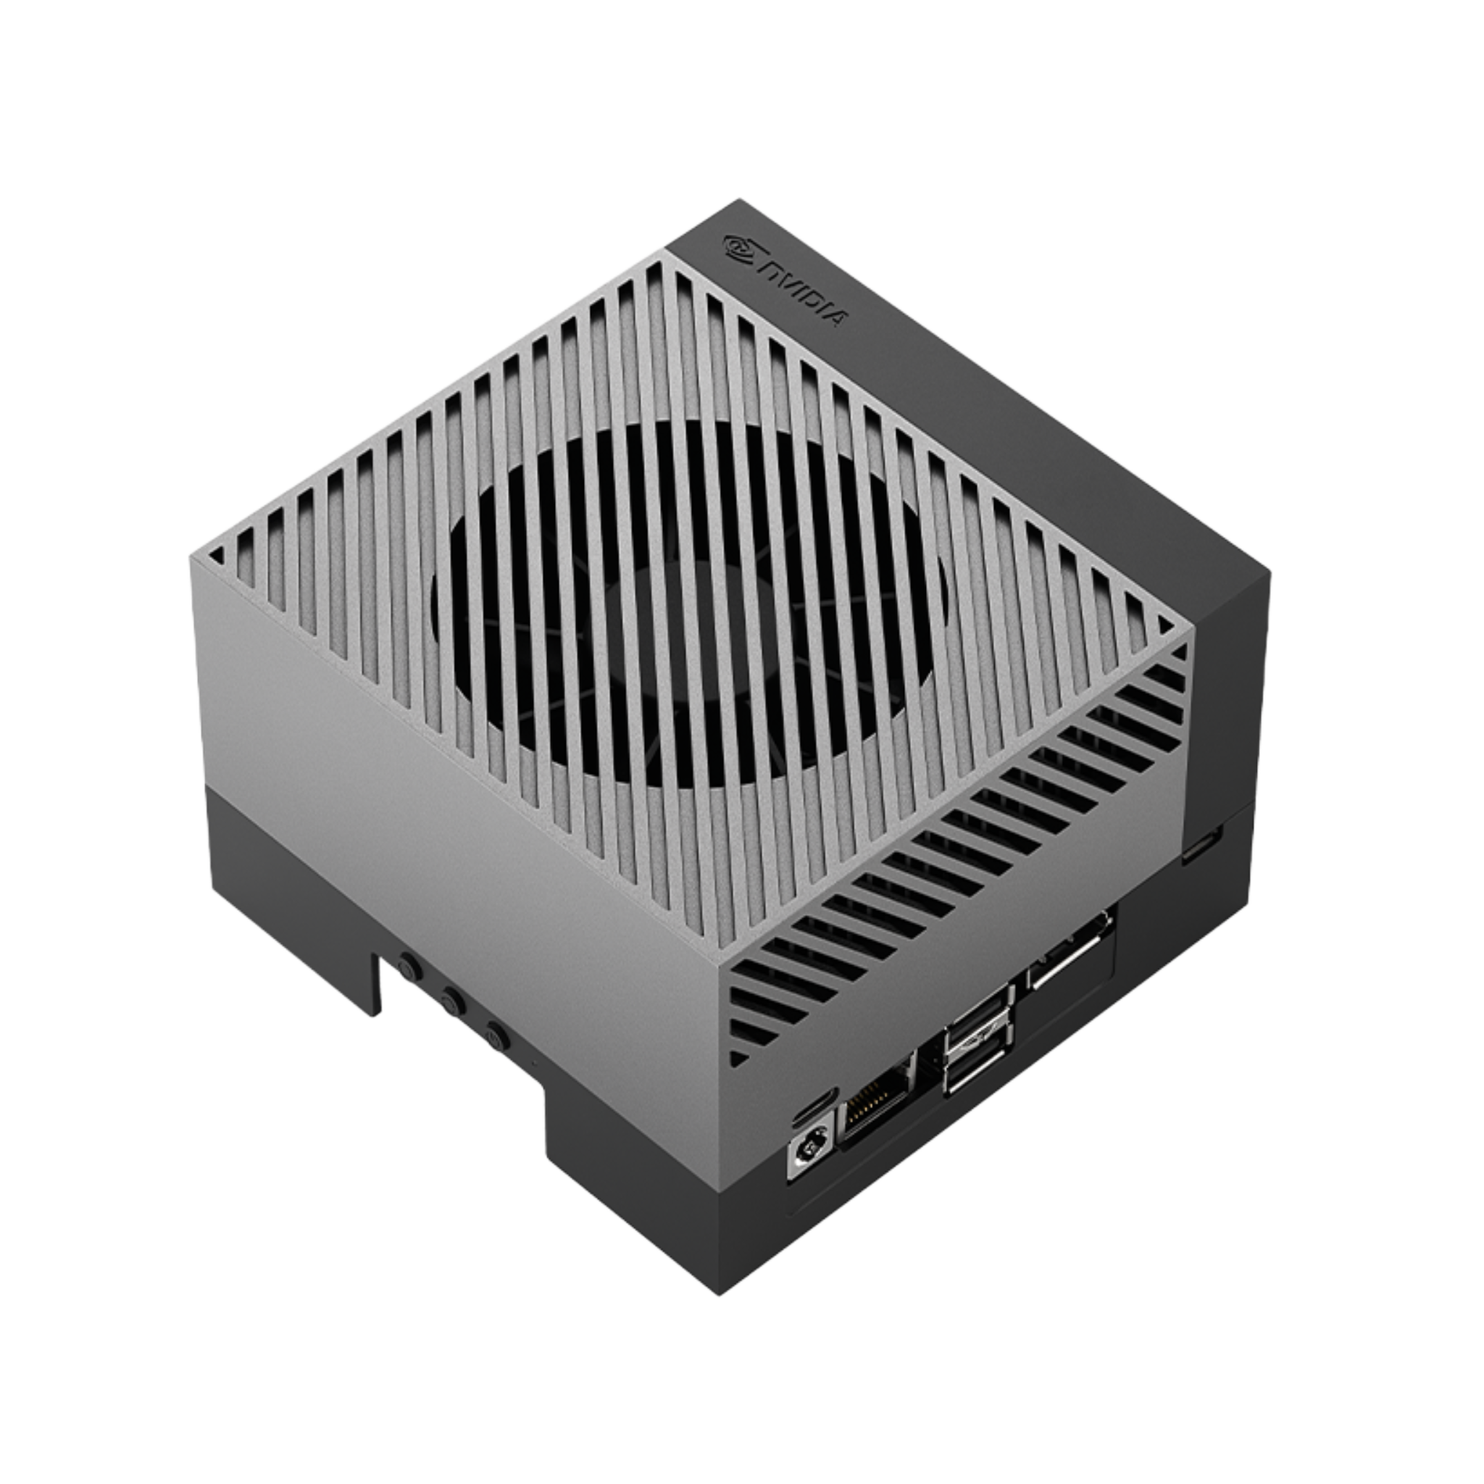


What’s Missing Today
Existing Solutions
Assume capable edge devices
Require application rewrites
Rely on weak or proprietary security
MCU characteristics
Energy-efficient
Optimized for local execution
Key tension
Accuracy vs deployability

Slide 5
What’s Missing Today
Gaps
Microcontroller support
Secure onboarding
Transparent offloading when local execution breaks?

Slide 6
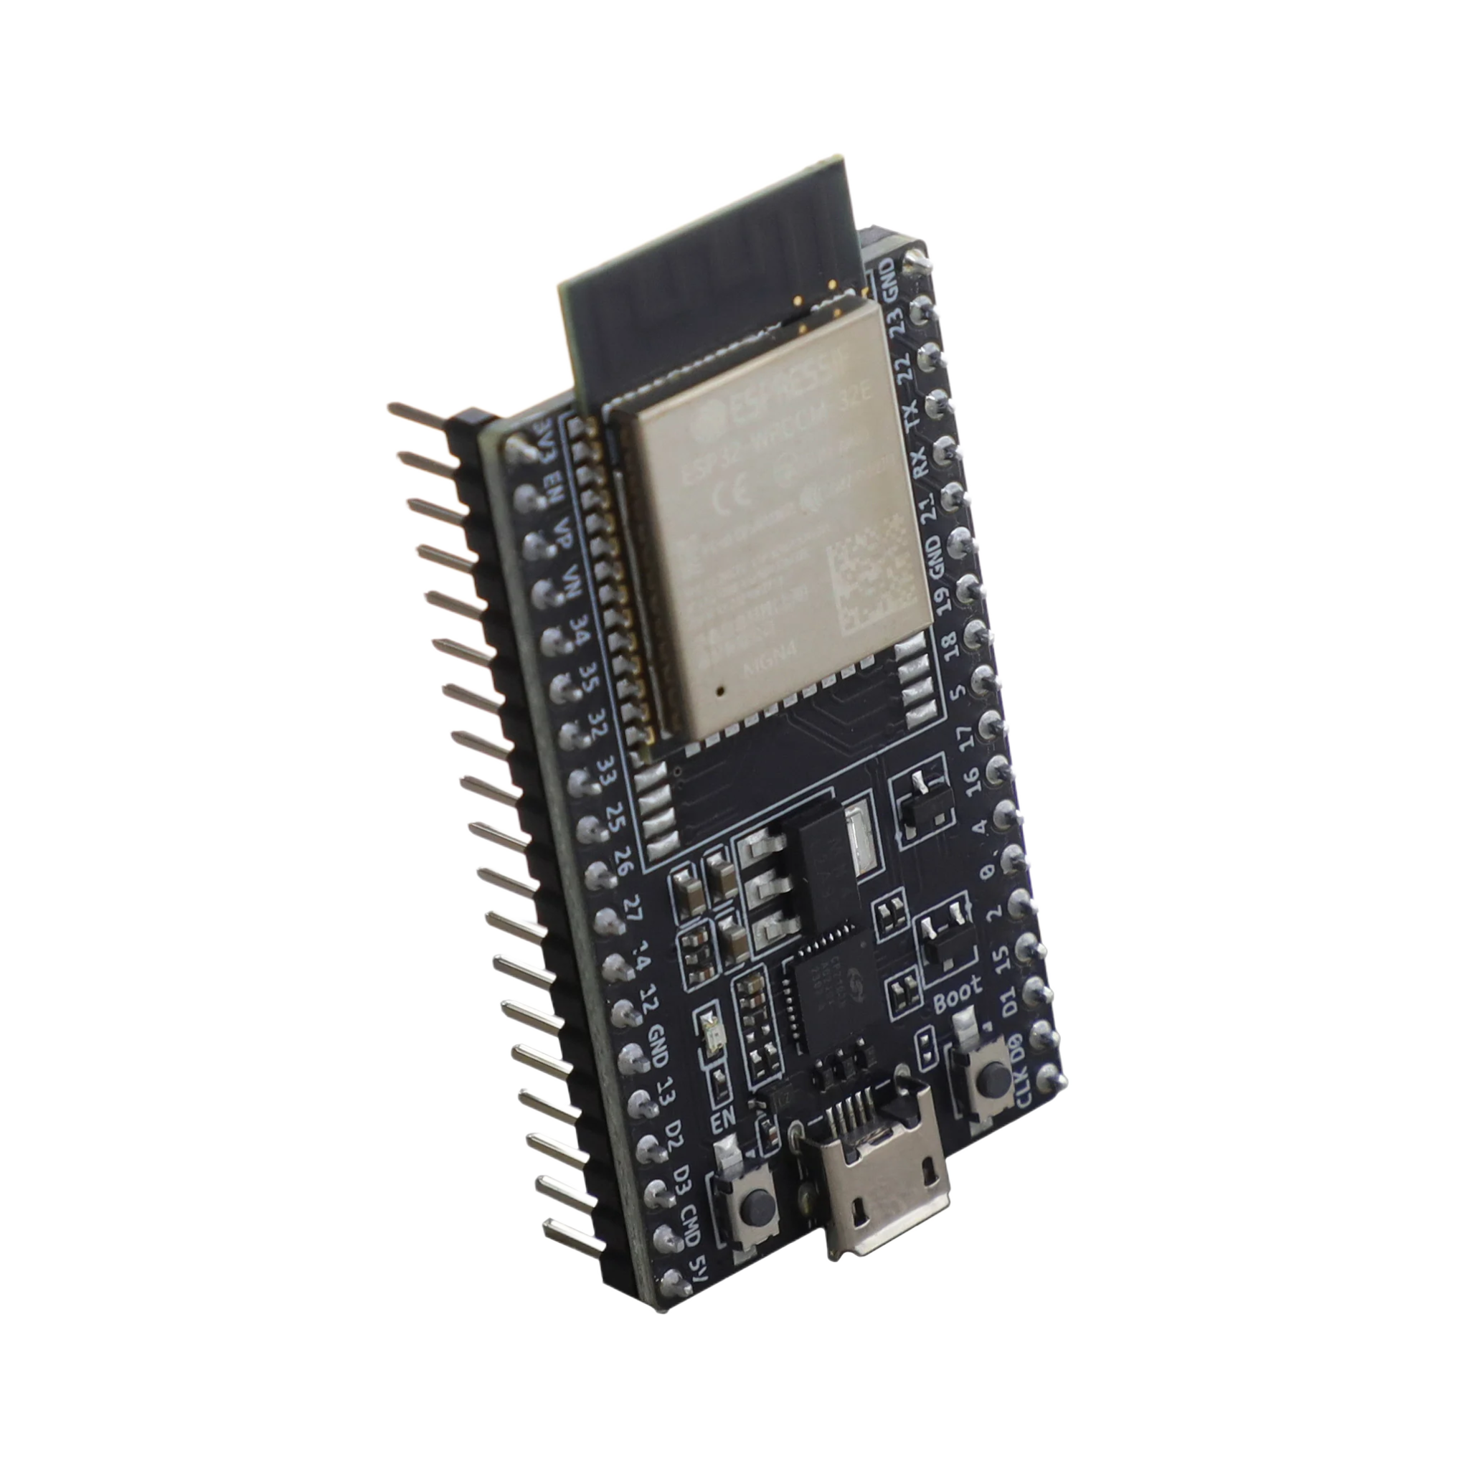




Our Goals
We want
No application changes
Secure by default
Runs across the device continuum
Cloud-native
Automatic offloading
Same application API, pick where the inference runs at runtime
This leads to MLIoT!

Slide 7





MLIoT Overview
Three pillars
Secure onboarding (DICE+EATs)
Cloud-native orchestration (K8s + Akri)
Transparent offloading (vAccel)
Notes:
Emphasize “transparent” and “production-grade”

Slide 8


Secure Device Onboarding
Security stack
DICE -> device identity
EATs -> runtime integrity
Secure boot on the MCU
Why it matters:
Trusted delegation
Only verified devices can offload
Secure OTA updates
Firmware updates preserve identity
Notes:
Emphasize “transparent” and “production-grade”

Slide 9
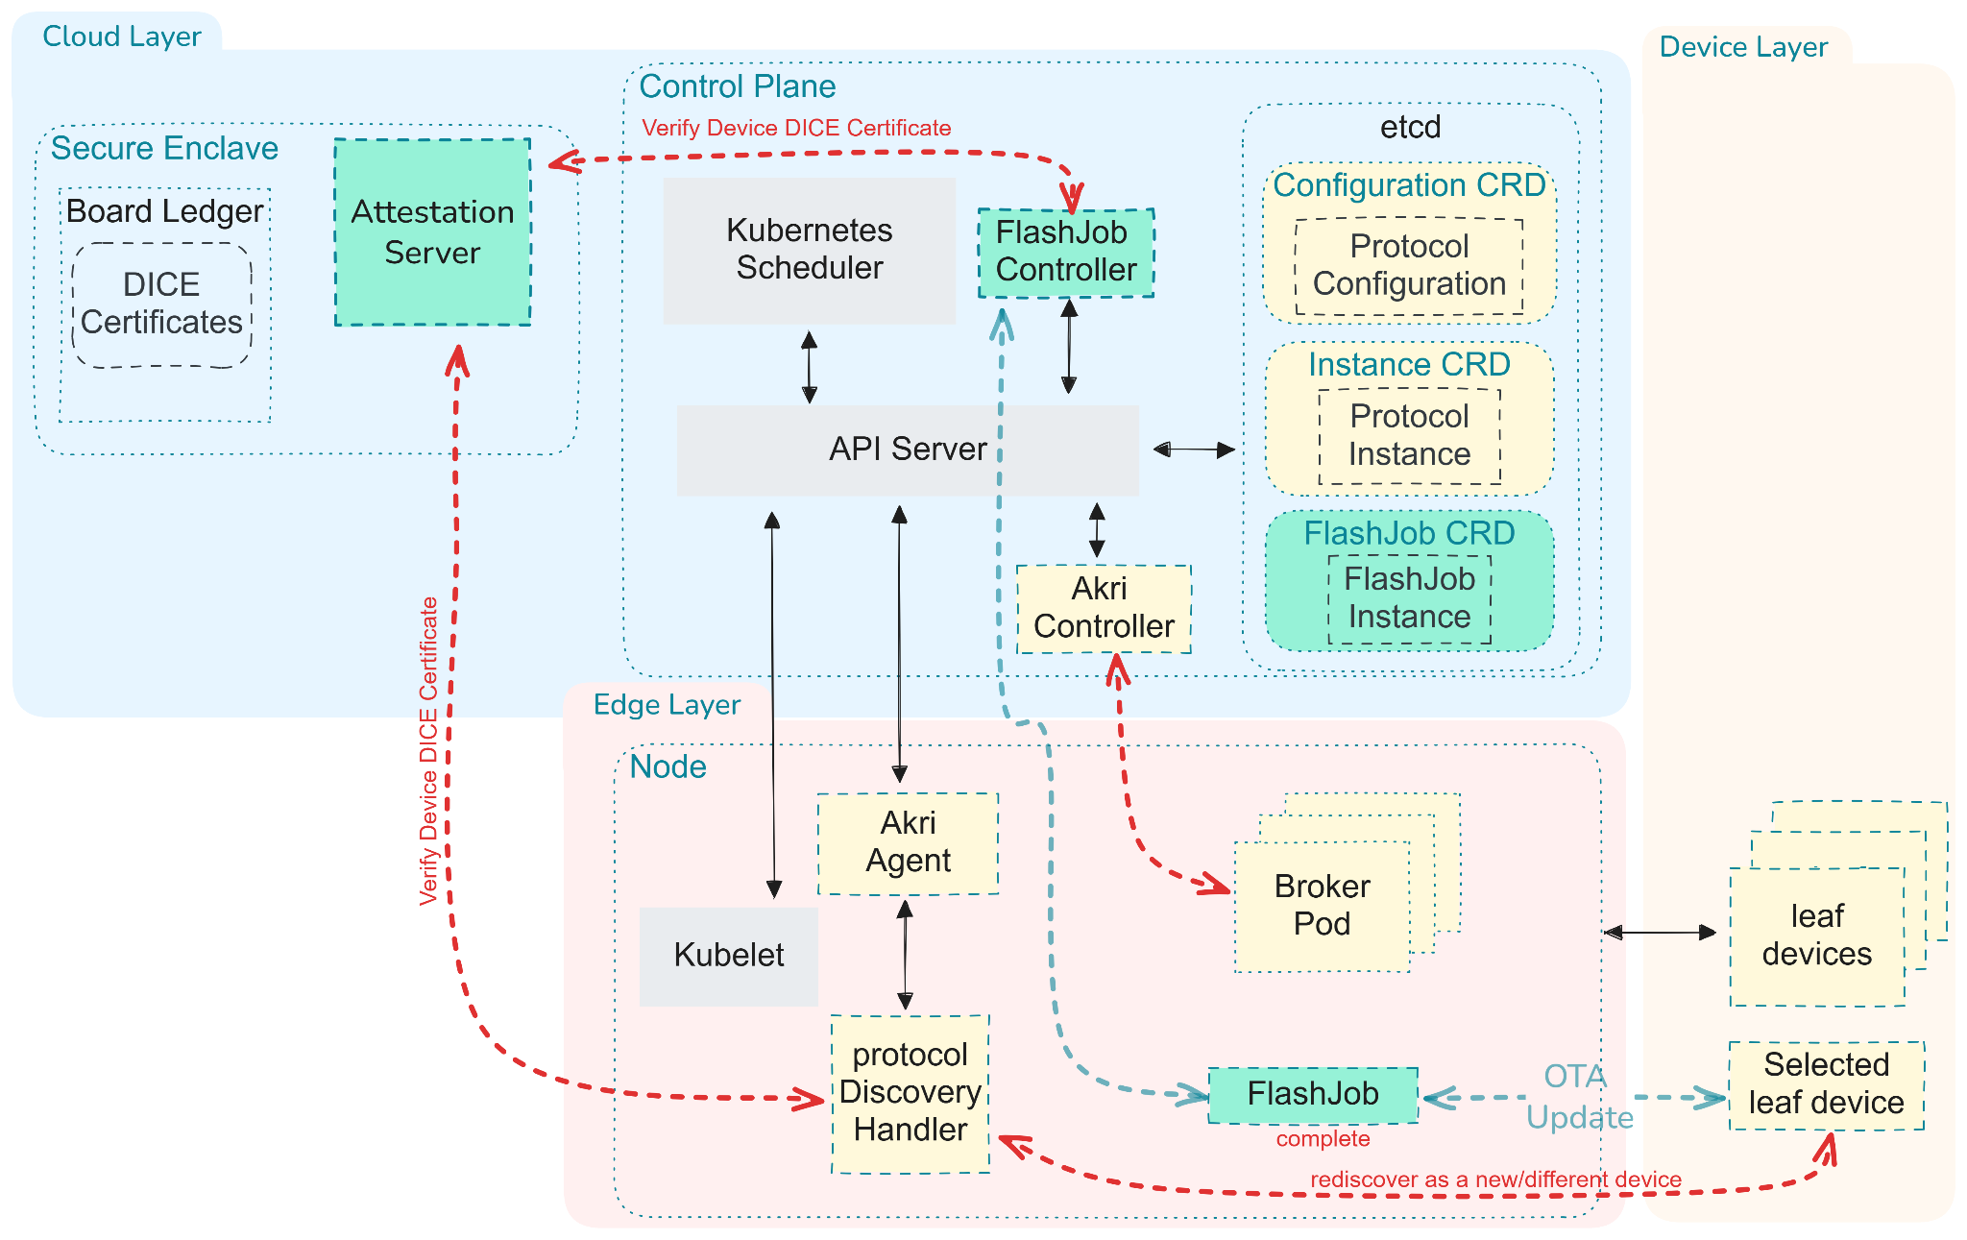
IoT as Cloud-Native Resources
Akri + Kubernetes
Device discovery
Inventory
Scheduling
MLIoT extension
Custom CRDs
vAccel-aware controller

Slide 10
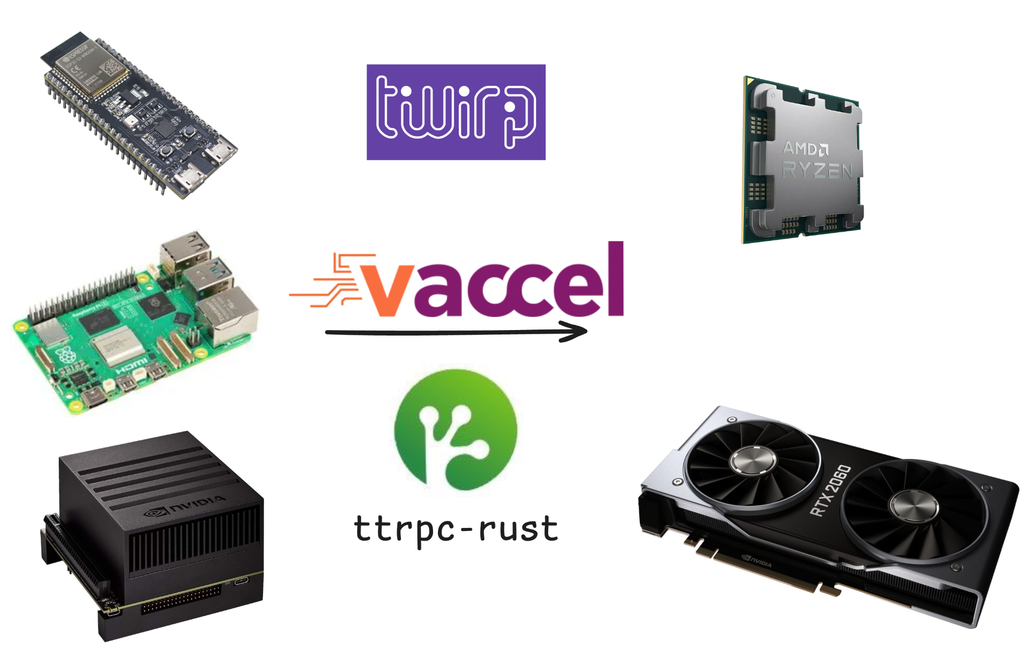
Device Continuum
Three tiers
IoT: MCUs, low-end Pi
Edge: Pi 5, Jetson
Cloud: x86 + GPU
Same ML workload, dynamically placed across the continuum
Notes:
Emphasize “transparent” and “production-grade”

Slide 11
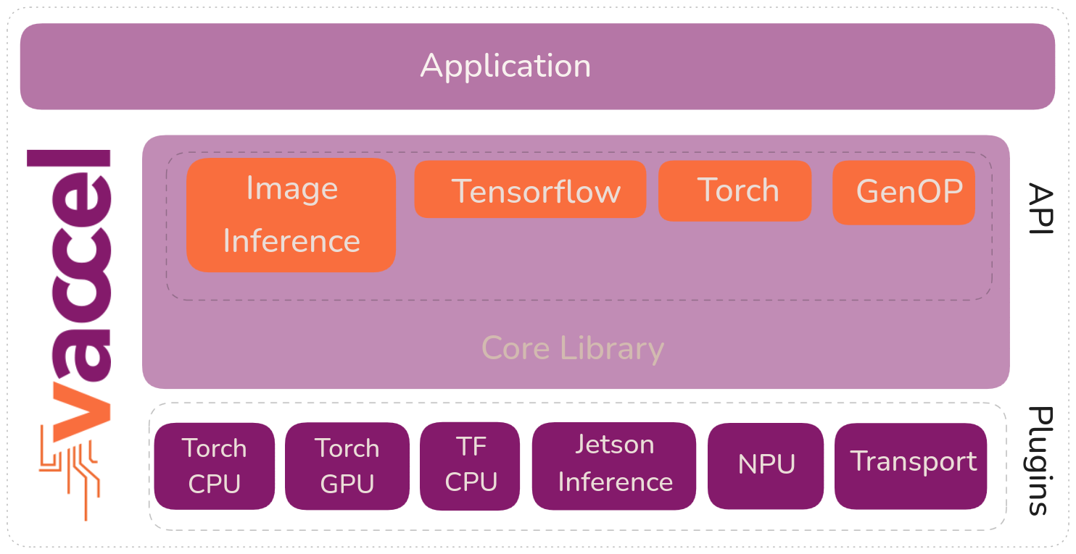
Where vAccel fits
vAccel
Unified API remoting for ML
Hardware-agnostic execution
CPU / GPU / Accelerators
Pluggable backends
Same code path, different placement
Notes:
Emphasize “transparent” and “production-grade”

Slide 12
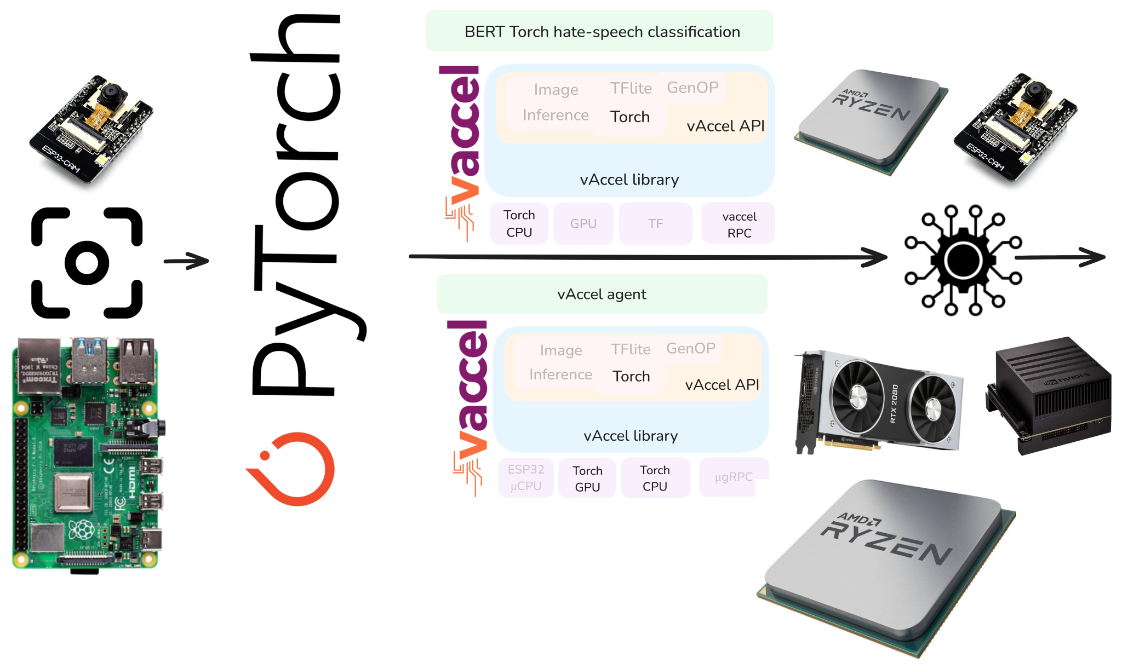
Where vAccel fits
The device doesn’t know where inference runs
Notes:
Emphasize “transparent” and “production-grade”

Slide 13
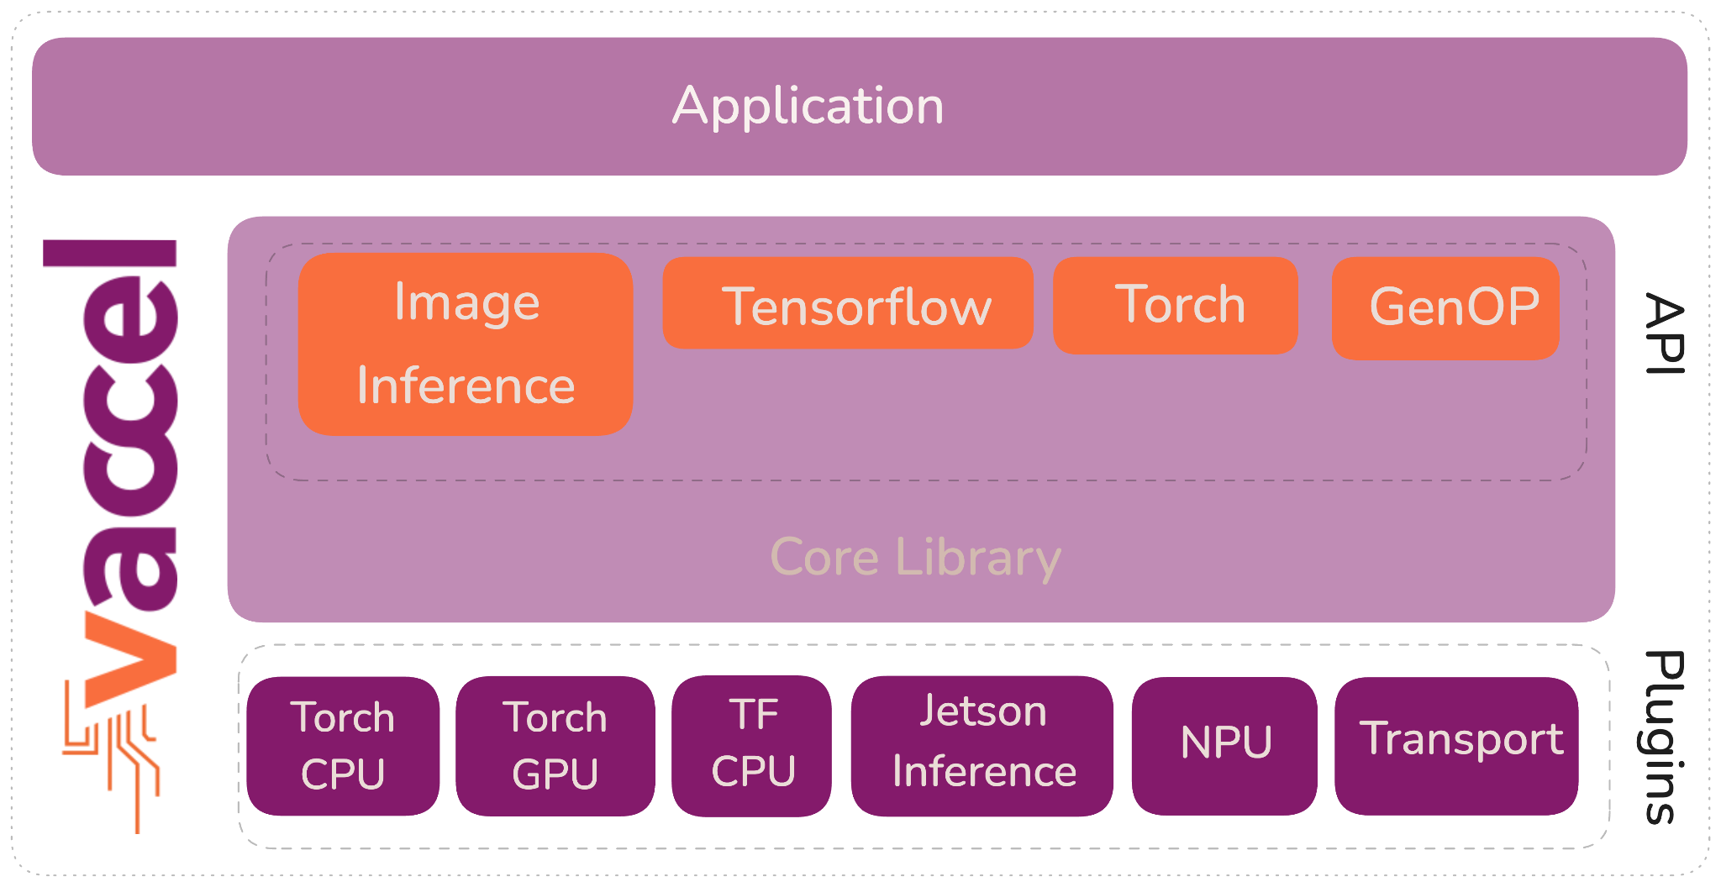

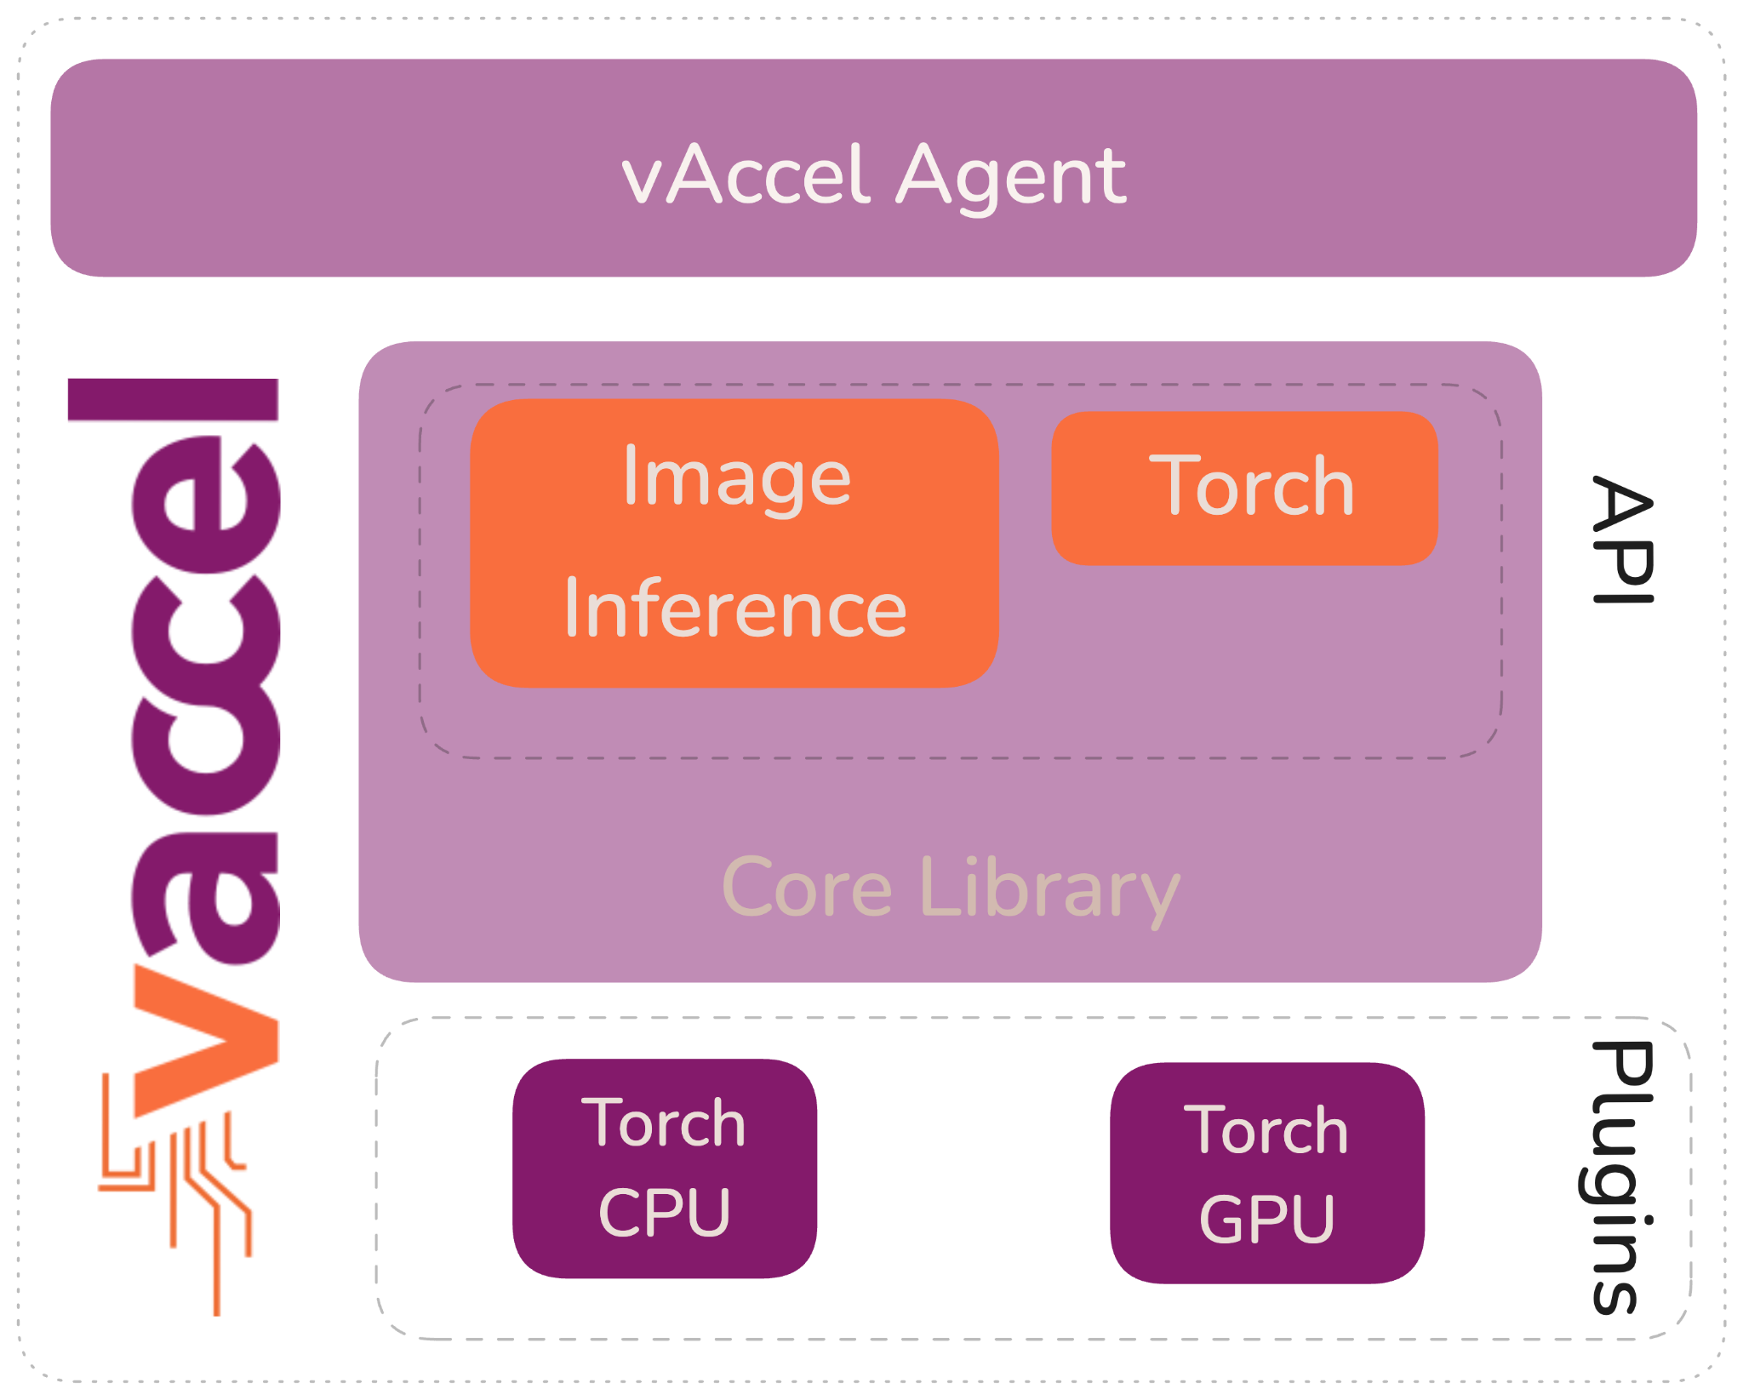
vAccel RPC Architecture
Problem
Embedded devices can’t run heavy RPC stacks
Accelerators are often unavailable locally
Solution
RPC plugin inside vAccel
Transport abstraction
Execution Model
Caller: MCU without accelerator (vAccel + RPC plugin)
Executor: accelerator host (RPC agent + vAccel + acceleration plugin)
Effect: same vAccel API, remote execution

Slide 14


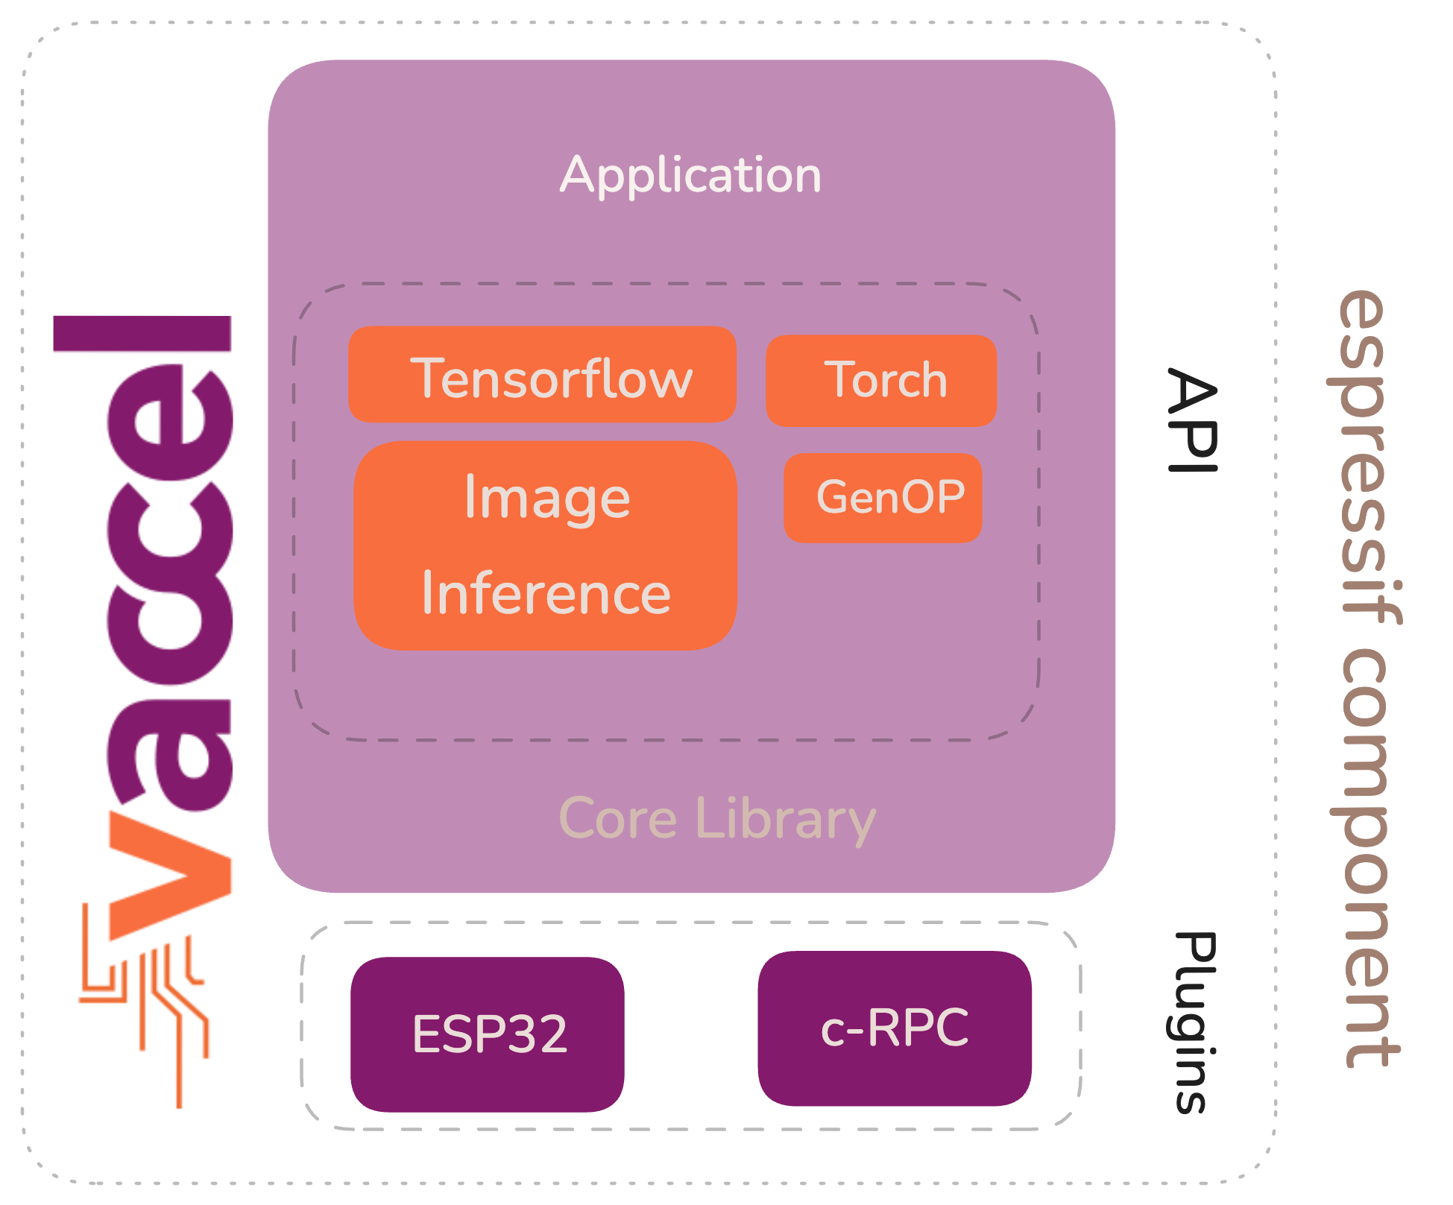
Why Twirp (Key Engineering Choice)
Ttprc vs Twirp
ttrpc-rust: fast, but a bit heavy
Twirp: HTTP/1.1 + Protobuf
Why Twirp wins for MCUs
C-friendly: firmware friendly
Minimal footprint: fits MCUs
No HTTP/2: less complexity

Slide 15
Testbed Overview
Hardware
MCU: ESP32-S3
Edge CPU: Raspberry Pi 5
Edge GPU: Jetson AGX Orin
Cloud CPU: amd64 (AMD Ryzen 5 2600)
Cloud GPU: NVIDIA RTX2060 SUPER
Inference Stack
vAccel
RPC transport
Models
MobileNetV2
MobileNetV3 (small variants)
Width multipliers: 0.5, 0.75, 1.0

Slide 16

What We Measure
Metrics
End-to-end latency
Top-1 / Top-3 agreement with the high-accuracy model
Confidence deviation
Efficiency (top-1 agreement / ms)
Reference (ground truth)
Full-precision MobileNetV3-Large on x86
Notes:
For each model, we evaluated 50 images from the ImageNet validation set. We record inference latency (end-to-end), Top-1 and Top-3 agreement with the reference model, and confidence deviation, computed as the difference between the predicted class softmax confidence and the corresponding confidence produced by the reference model.

Slide 17
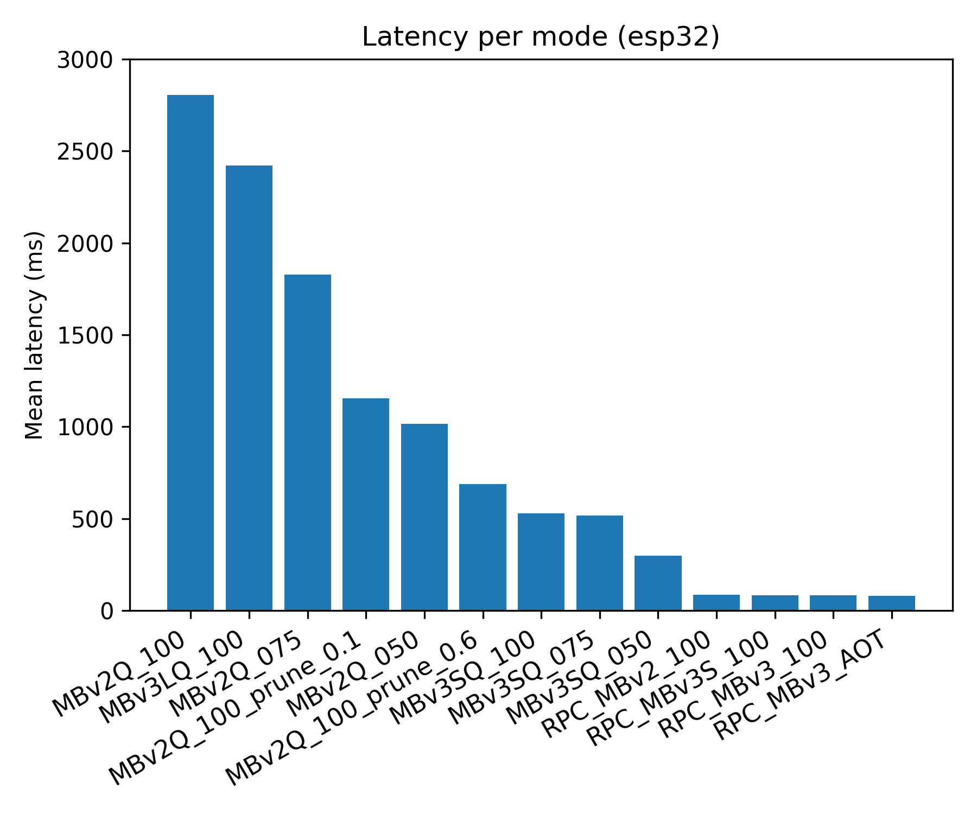
ESP32: Local vs Offload
Key results
Local inference
Quantized models: 1-3s latency
Limited accuracy due to aggressive quantization
> 20x latency reduction
Remote offload (vAccel RPC)
~47ms end-to-end latency
Top-1 agreement ~90% with the full model
Notes:
Here we see the results we got on the local versus offloaded implementation. Note that we also tried pruning and AOT …..We actually get

Slide 18
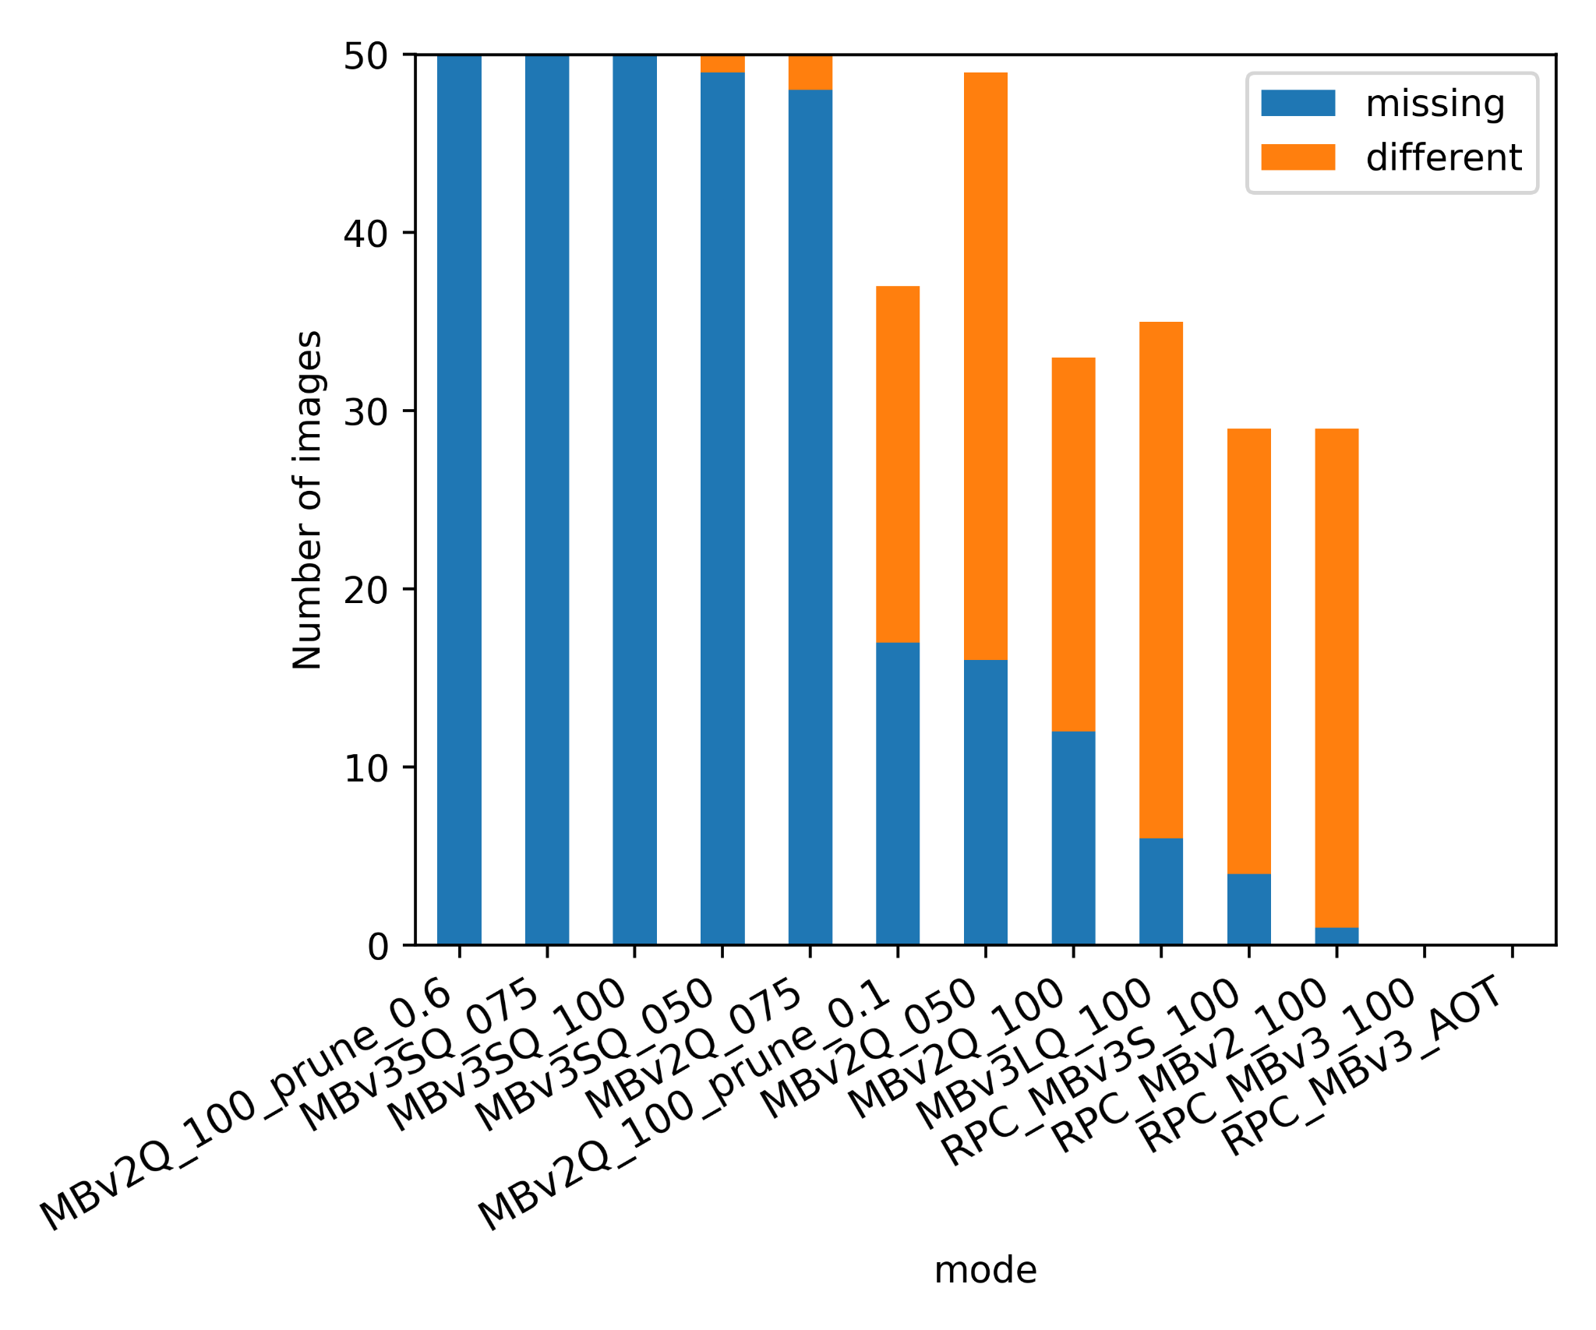
Quantization Pain Is Real
MobileNetV3
SE blocks amplify error
Per-class Top-1 accuracy drops exceed 15% (quantized vs full-precision reference)
Implication: Some architectures simply don’t belong on MCUs (even with mixed precision or QAT)
Notes:
One thing we learned along the way is that post-training quantization can be very unstable for some model architectures. MobileNetV3 is a good example. It uses squeeze-and-excitation blocks, which take a very small signal and use it to scale whole feature maps. When that signal is quantized tiny numerical errors end up getting amplified. This is made worse by sigmoid or h-swish activations, which have narrow ranges and are flattened when quantized. In the figure on the right, many local MCU runs either miss the correct class entirely in the top-3, or confidently predict the wrong one.

Slide 19
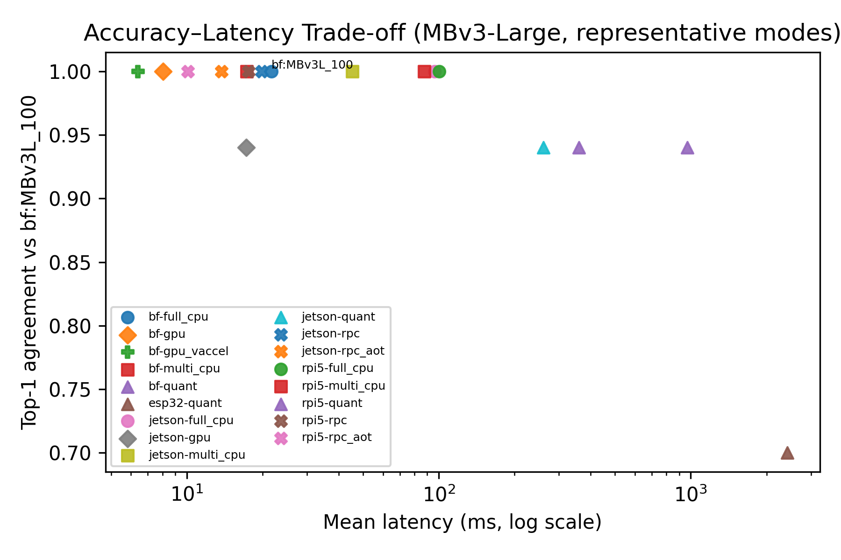
Accuracy vs Latency Trade-off
Fast & Accurate
Slow & Accurate
Local = slow & inaccurate
Offload = fast & accurate
Implication: Even if we use “softer” quantization the result could still be slow & inaccurate
Slow & Inaccurate
Notes:
(Figures 8–10 combined conceptually)

Slide 20
Efficiency: Correct Predictions per Millisecond
Efficiency metric captures the accuracy-latency trade-off
ESP32: ~20x improvement via offloading
RPi5 / Jetson: ~3-5x improvement
Takeaway
Offloading is not optional - it’s necessary!
Benefits grow as we have more constrained devices
Notes:
Figure 4 summarized

Slide 21
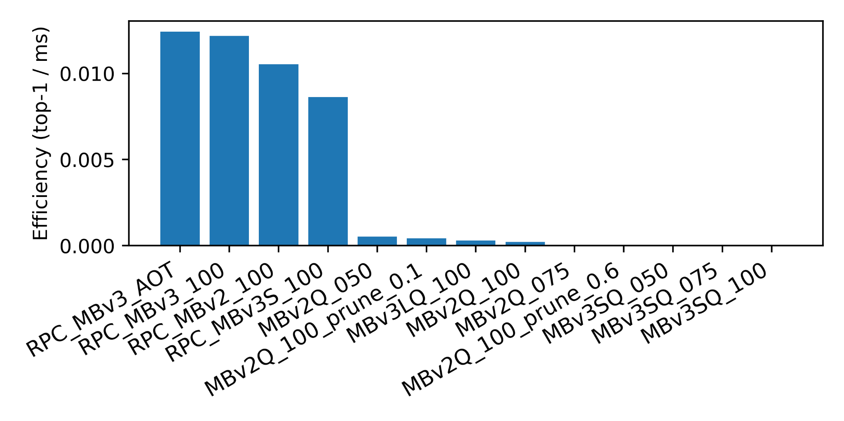
Efficiency: Correct Predictions per Millisecond
remote
Higher is better
local
Notes:
Figure 4 summarized

Slide 22

What we learned
Local ML on MCUs is fragile
Severe memory constraints force aggressive quantization
Quantization can break semantic classes
Even with mixed precision
Transparent offloading resolves both
Network overhead is outweighed by latency and accuracy
Notes:
(Figures 8–10 combined conceptually)

Slide 23

Why This Matters
MLIoT enables
Real deployments
Secure scaling
Hardware reuse
No application rewrites
Open source
https://github.com/nubificus/cloud-native-iot
https://github.com/nubificus/esp32-rpc
Notes:
(Figures 8–10 combined conceptually)

Slide 24




Thank you! Questions?
nubificus
Also find us @ BSD, illumos, bhyve, OpenZFS Devroom
17.15: Bringing BSD Applications on Linux container platforms with urunc
This work is partially funded through Horizon Europe Research and Innovation actions MLSysOps (GA: 101092912) and EMPYREAN (GA: 101136024).

Slide 25
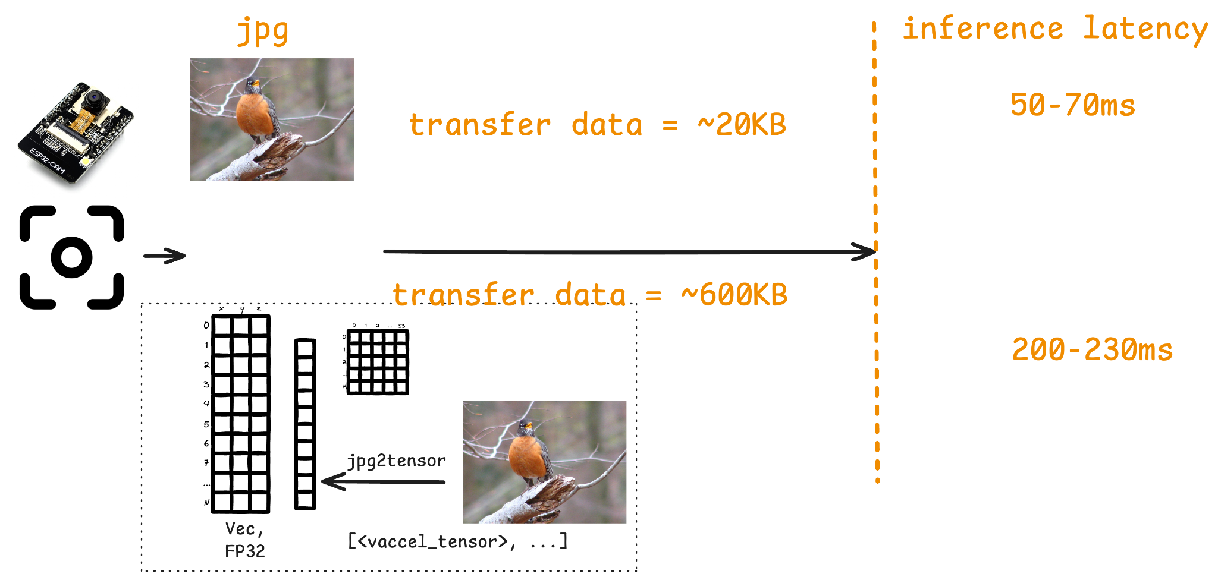
Transport trade-offs
Notes:
(Figures 8–10 combined conceptually)

